Slide 1



Oral Health Care
For Children With
Disabilities in Maine
Autumn 2023

Slide 2



Disability Rights Maine and the Children’s Oral Health Network of Maine partnered to collect data to better understand the oral health care needs of children with disabilities.
The results of the project will be used to support ongoing work COHN is doing to increase access to oral health care for all children in Maine, and to advocate for changes that will improve accesss to and quality of oral health care for children with disabilities in Maine.

Slide 3



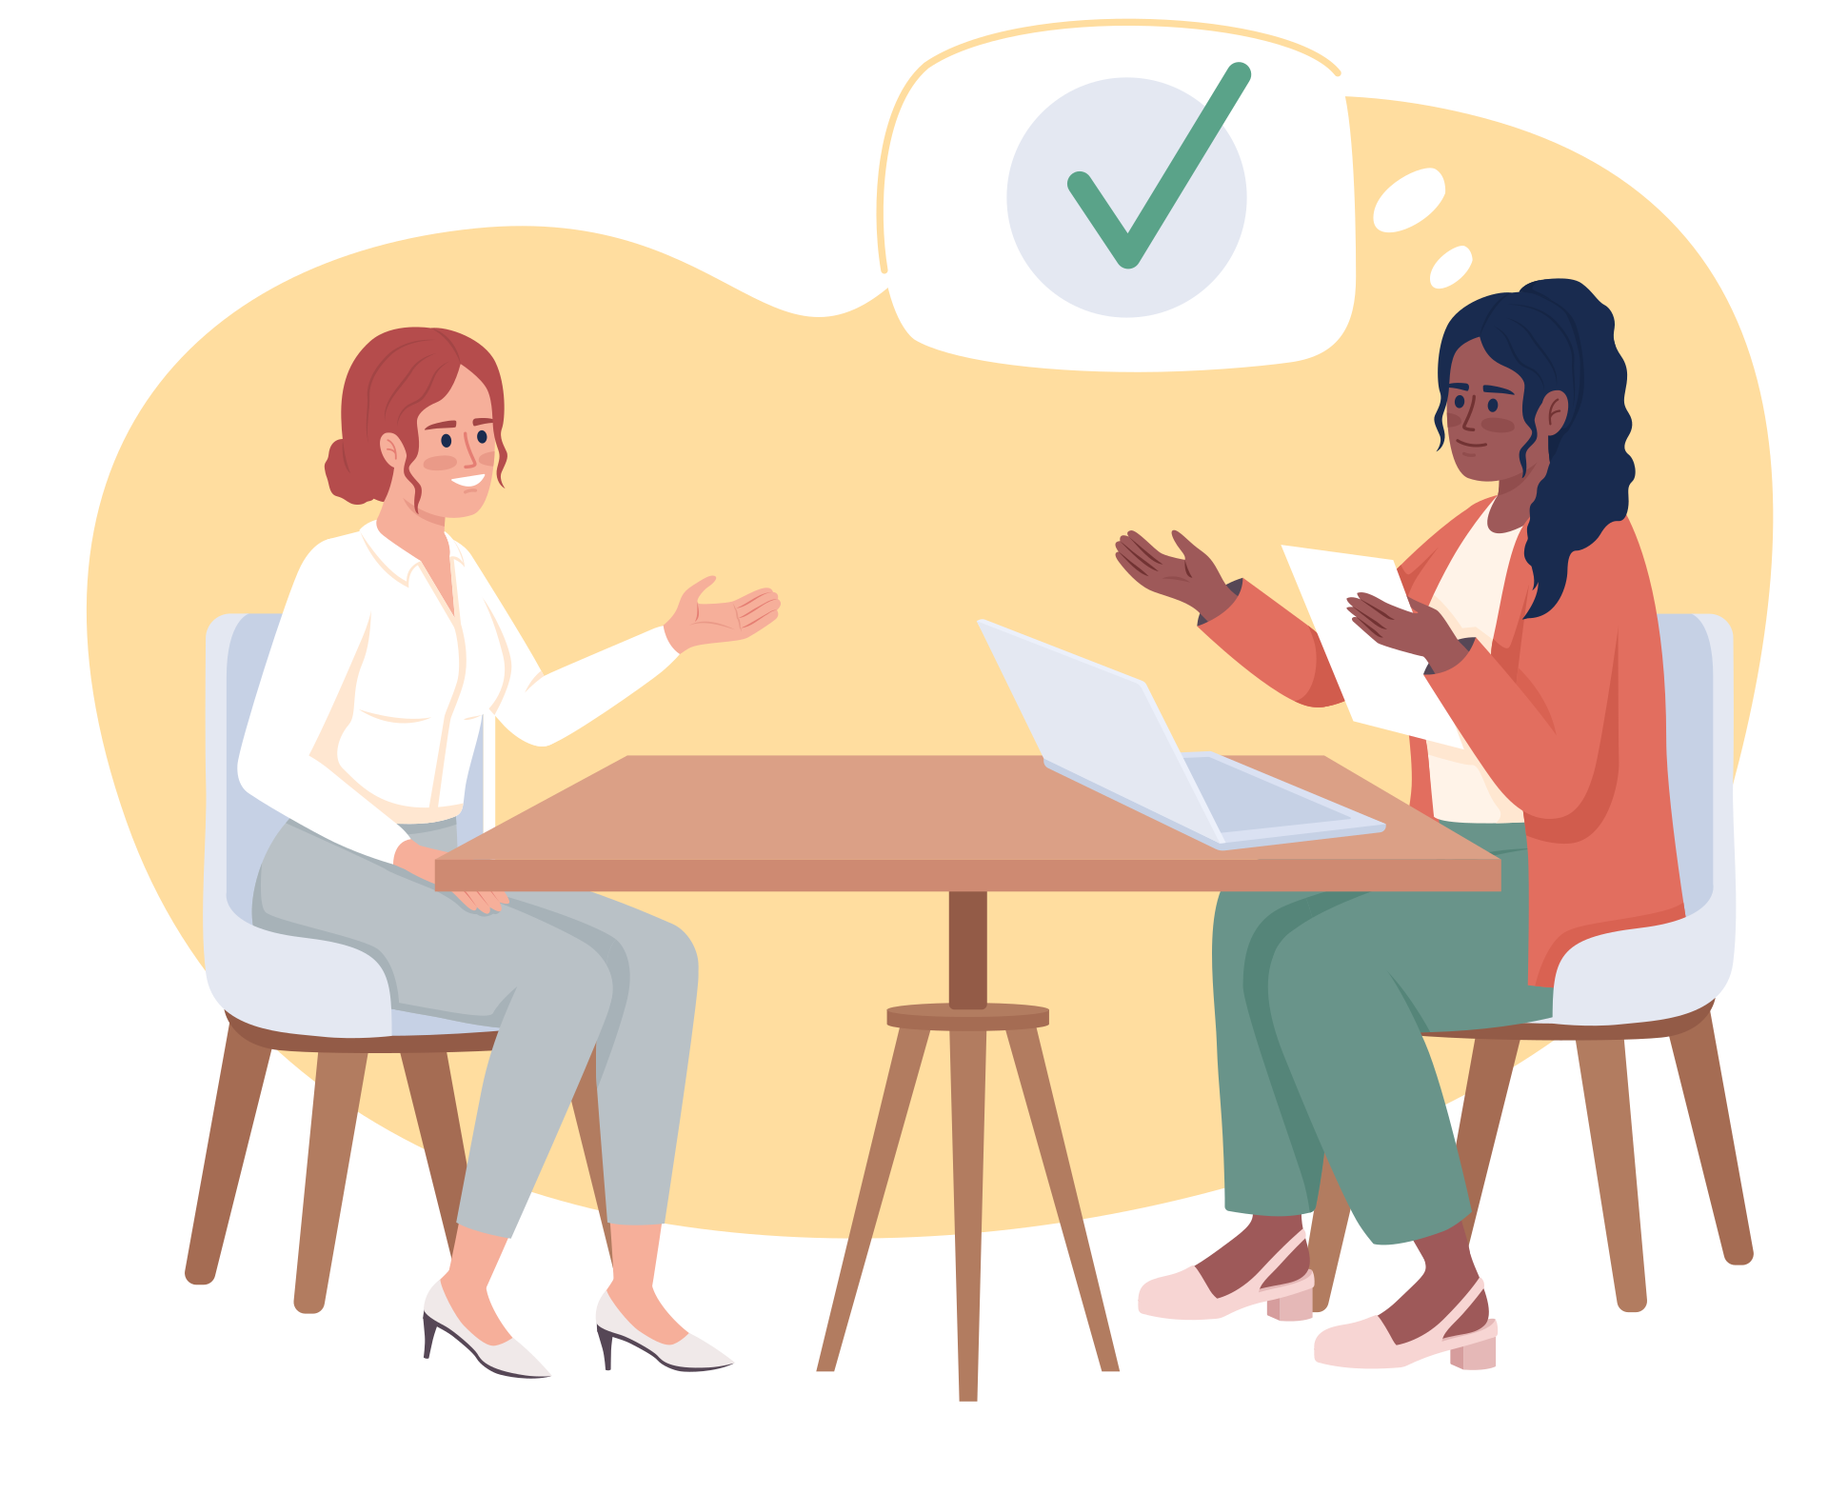
METHODOLOGY
Survey
Interviews

Slide 4
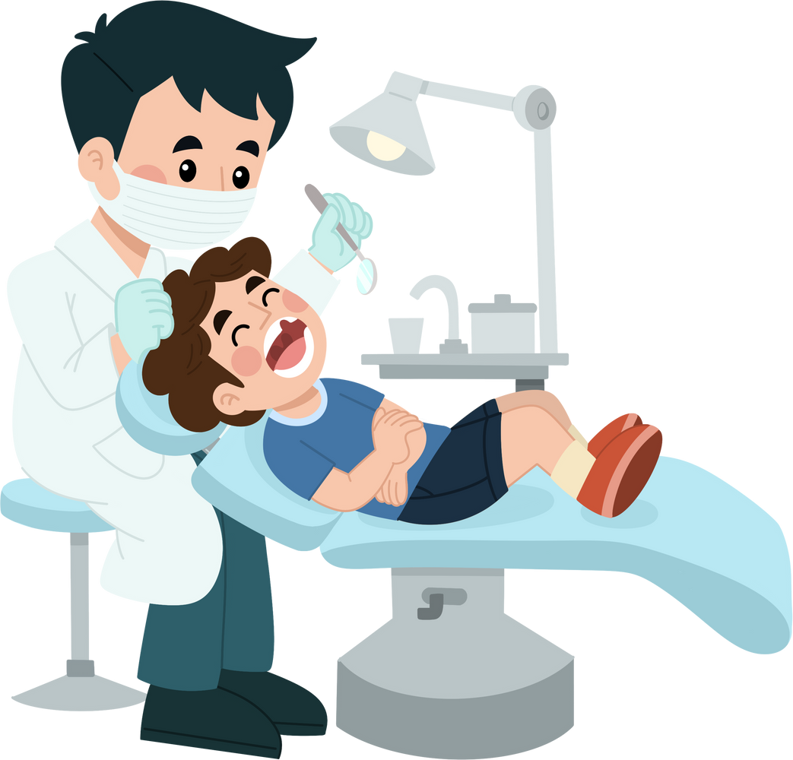
of children in families surveyed have an oral health care provider they see regularly.
69%
do not have an oral health care provider they see regularly.
31%

Slide 5


Why does your child not see an oral health care provider regularly?
  The providers do not provide the accommodations I need (56%)
  The provider does not feel able to meet my child’s needs (56%)
  There are no providers in the area (33%)
  Some other reason (33%)
  My child’s dental insurance does not cover the care they need (11%)
  I do not know how to find an oral health care provider (11%)

Slide 6
Are the oral health care providers you see able to provide care and support to your child that meets their needs?
None of the time
All of the time
8%
28%
40%
Some of the time
24%
Most of the time

Slide 7

A number of dentists stopped accepting MaineCare and it's incredibly difficult to find one who both takes our insurance and can offer sedation.

Slide 8
What type of disability does your child have?
Please check all that apply.
Blind or low vision
6%
Brain injury
9%
Chronic health condition
9%
Deaf or hard of hearing
3%
Intellectual/developmental disability or label
78%
Mental health condition or label
41%
Physical/mobility disability
28%
Uses a communcation device
9%
Something else
22%
0%
20%
40%
60%
80%

Slide 9
What type of dental insurance does your child have?
MaineCare
Other dental coverage plan
Private insurance
No dental insurance

Slide 10

What issues has your child experienced around oral health care?
  Unable to get oral health care when needed (57%)
  Does not want to brush or floss (48%)
  Experienced tooth decay, gum disease, or cavities (43%)
  Needed sedation, but could not find a place to provide it (24%)
  Provider did not allow enough time for the visit (19%)
  Provider did not speak directly to my child (14%)
  Some other issue (14%)
  Misdiagnosed oral health issue as a behavioral issue (10%)
  Provider declined to provide needed accommodations (10%)
  Provider said my child needed sedation, but this is not true (5%)

Slide 11
[The] dentist means well but is frightened of folks with disabilities and high anxiety. In the past, dental hygienists have explained that they do not have a duty to treat - if a child or adult is having difficulty, they can stop treatment, “we never received training on patients with disabilities or autism.”

Slide 12
My child’s age is:
18-21 years old
0-4 years old
5%
5%
5-11 years old
15-17 years old
40%
40%
10%
12-14 years old

Slide 13
My child’s race/ethnicity is:
American Indian/Alaska Native | 0%
Asian/Asian American | 4%
Black/African American | 8%
Hispanic/Latino | 4%
Native Hawaiian/Pacific Islander | 0%
White | 88%
I prefer not to answer | 4%

Slide 14
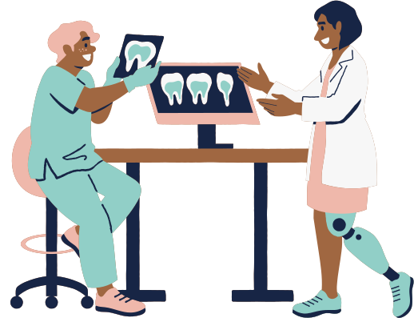
My child is currently living:
At home with family (91%)
On their own (6%)
In an institutional placement or treatment facility/program (3%)

Slide 15
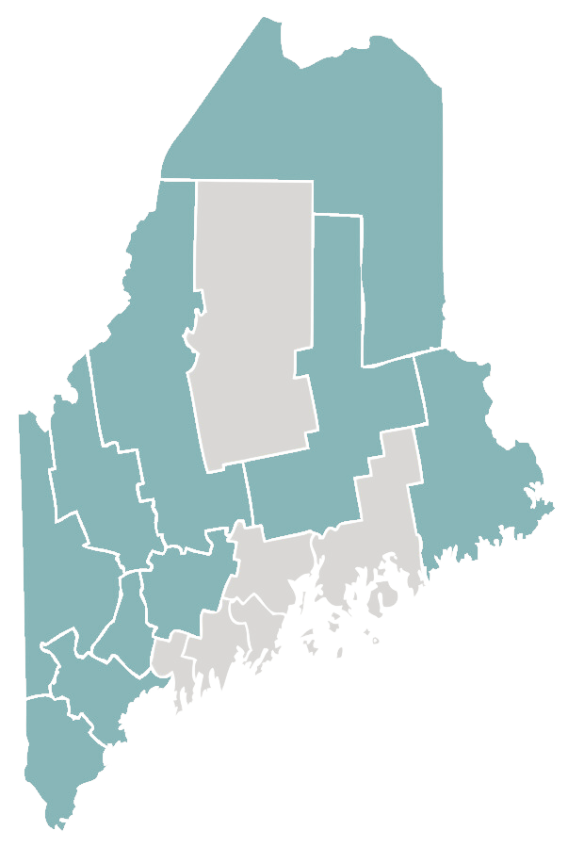
The county we live in is:
Received responses
No responses

Slide 16
FOR MORE INFORMATION
Kalie Hess
Jennifer Battis
Associate Director
Children’s Oral Health Network of Maine
kalie@mainecohn.org
Health Equity Project Coordinator
Disability Rights Maine jbattis@drme.org

